Slide 2
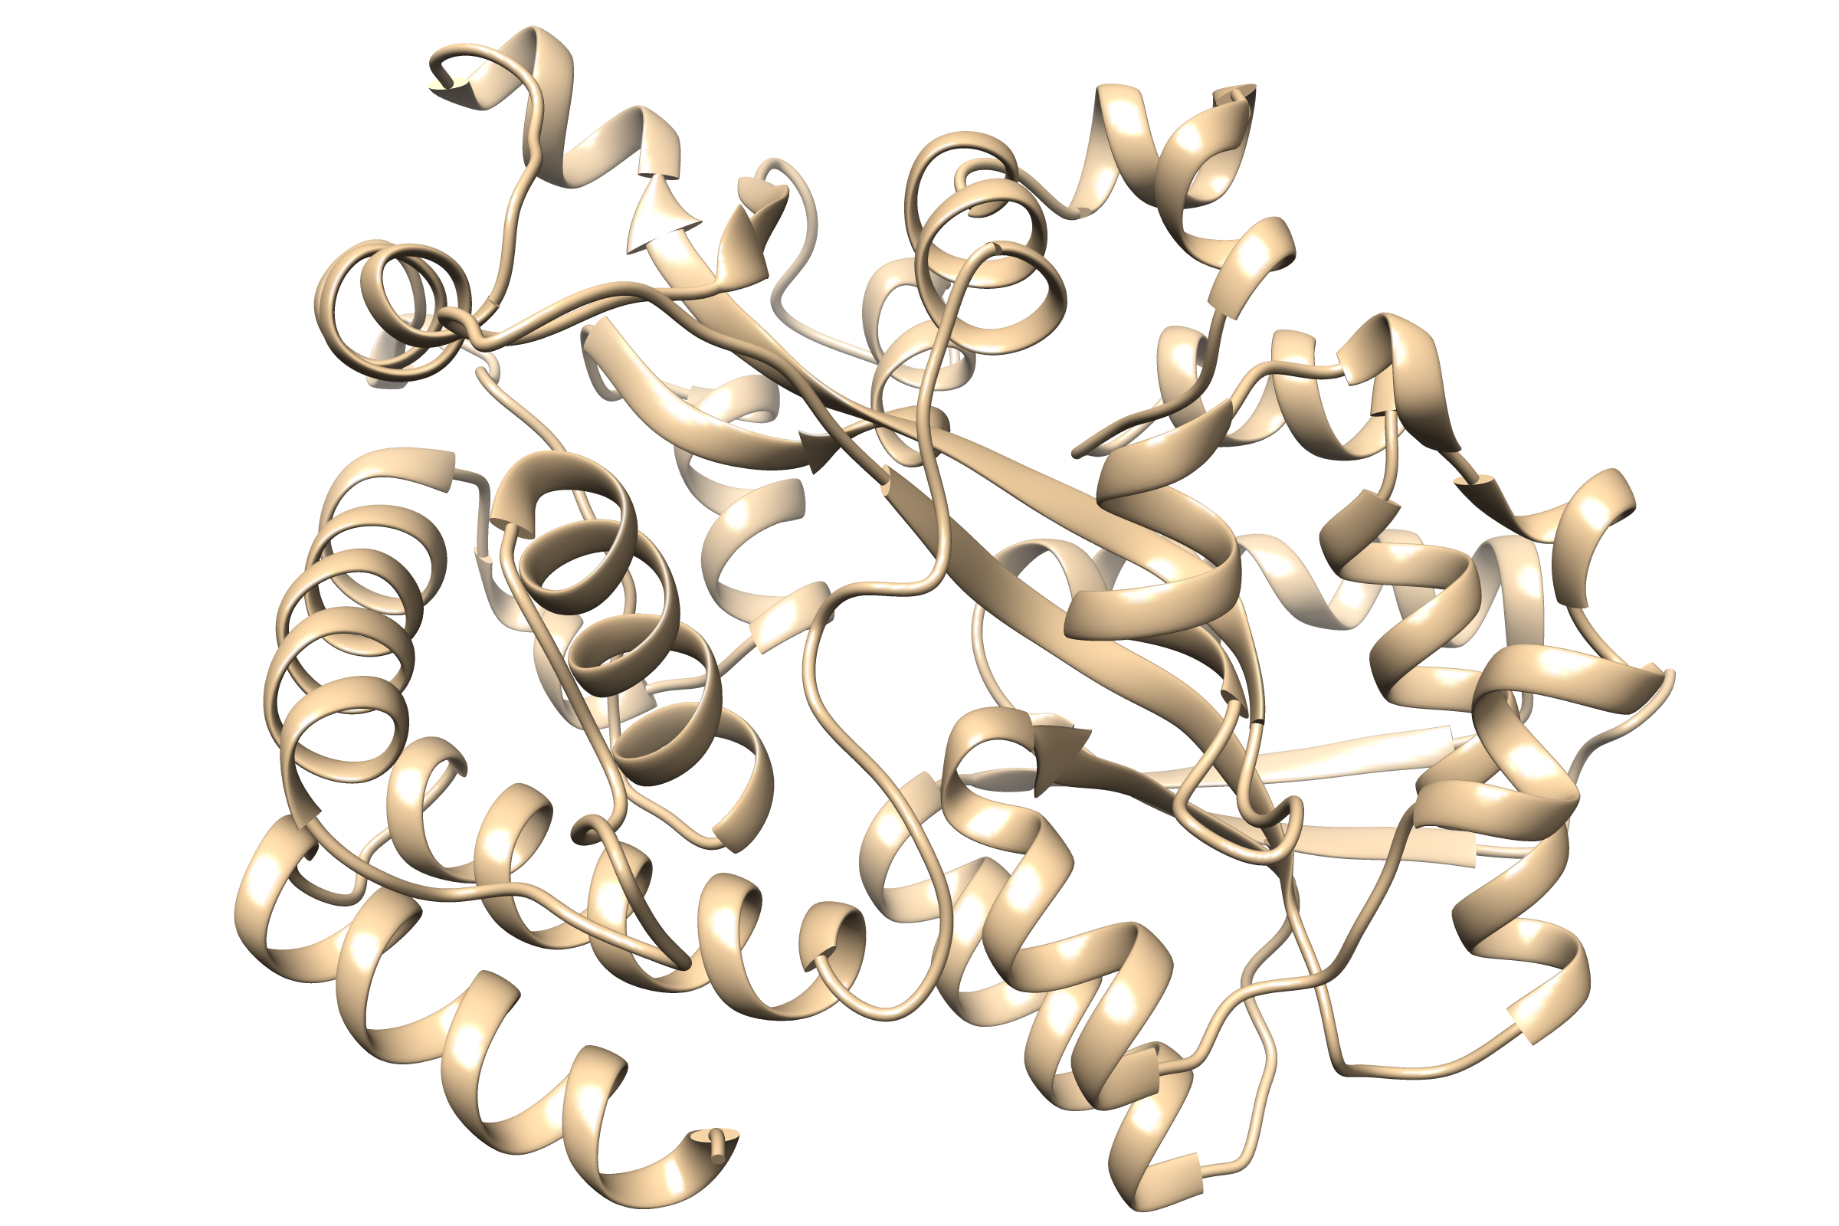
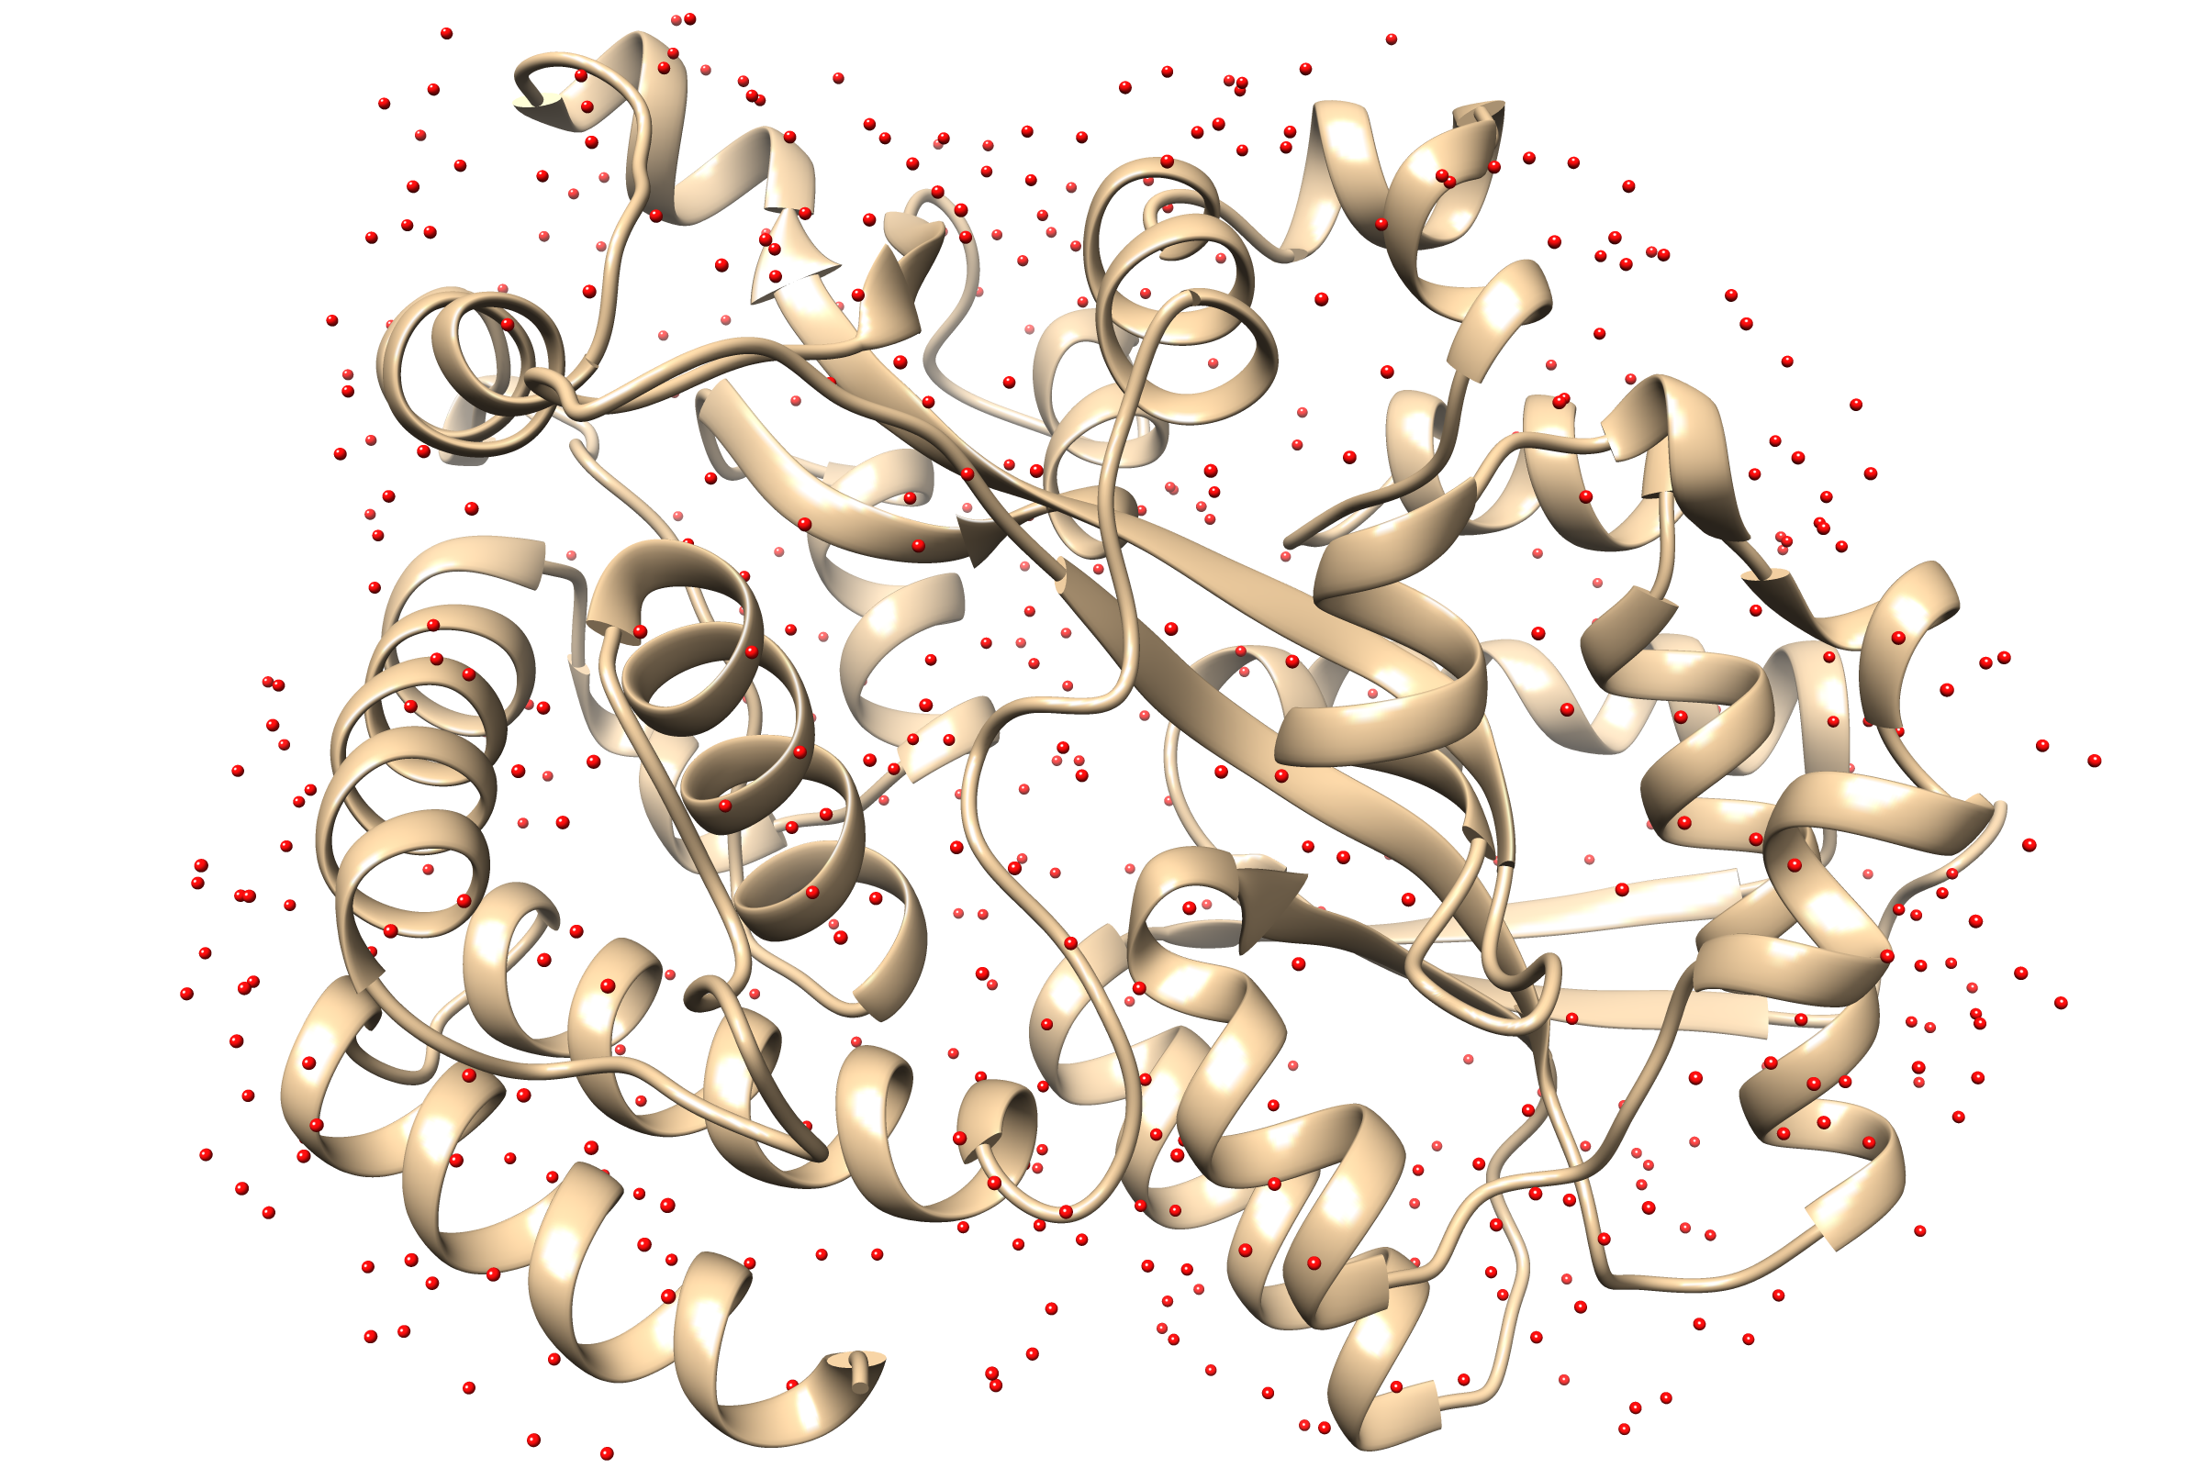
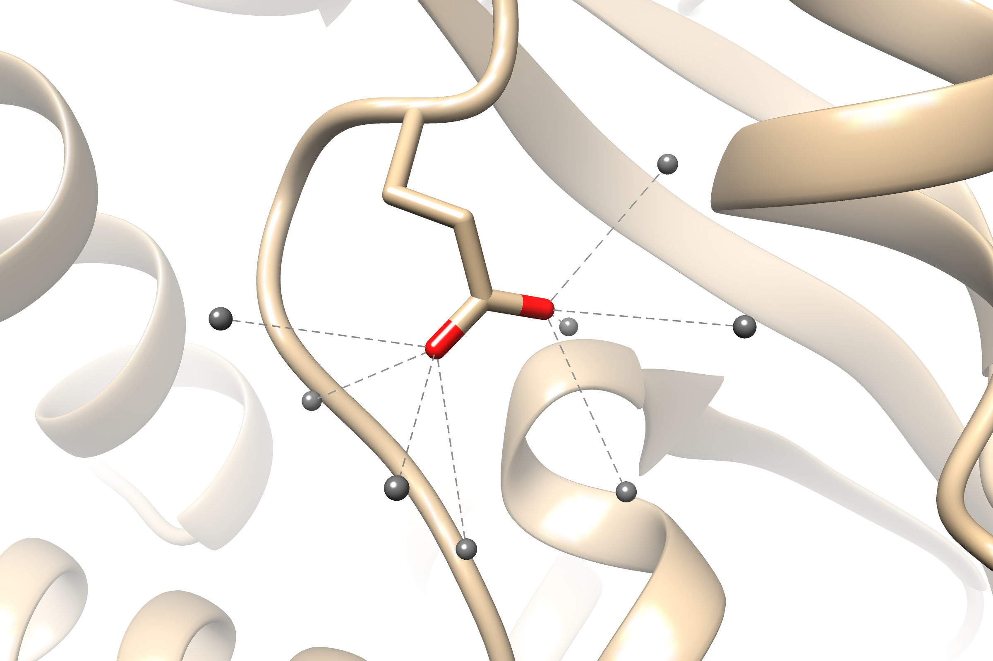
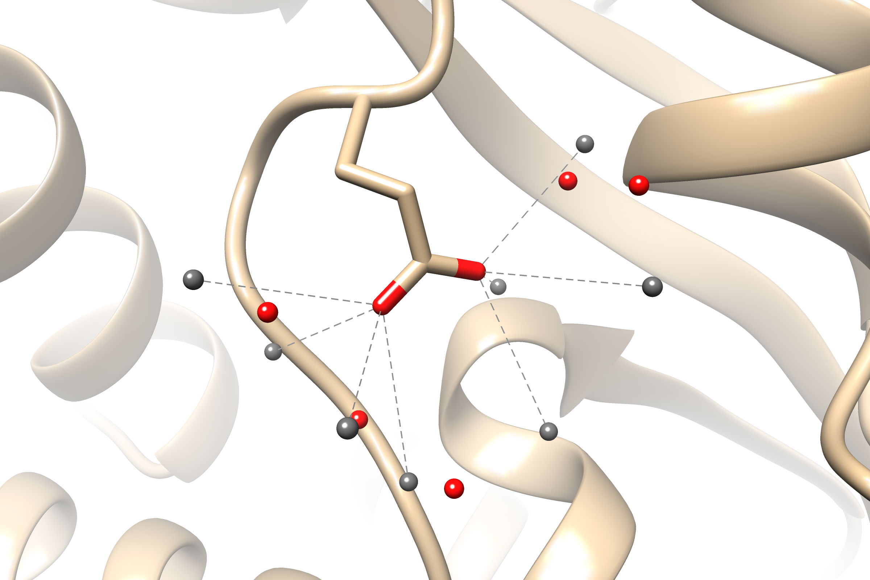
Fig 1
Probe building
Position clustering
SE(3)-GNN

Slide 3
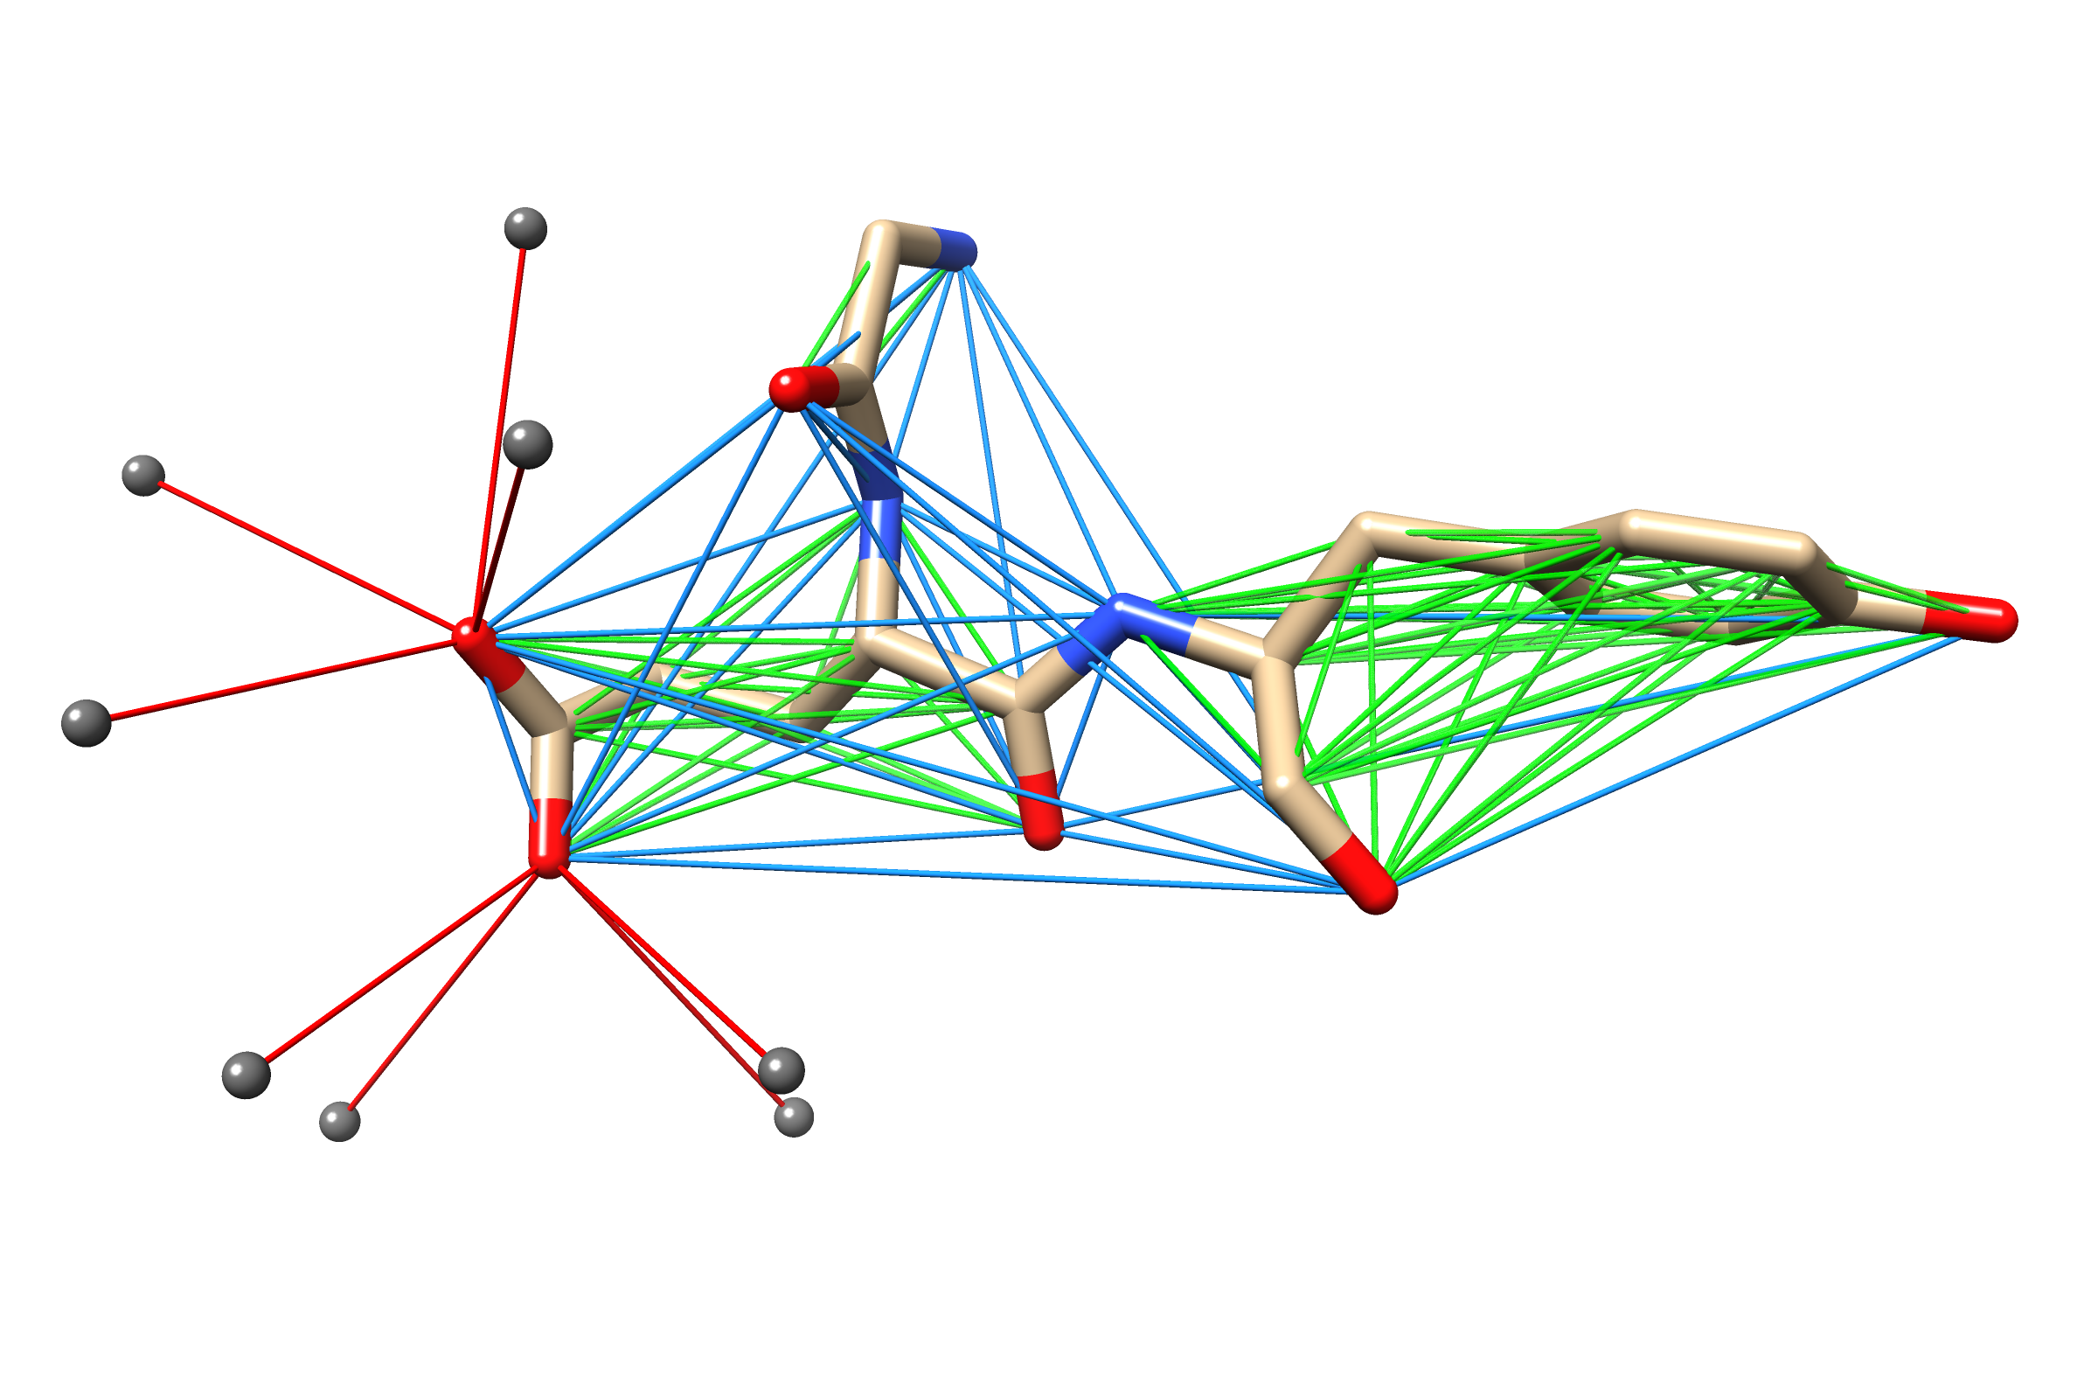
Fig 2
Probe – non-carbon atom connection
Intra-residual connection
Non-carbon atom pair connection

Slide 4
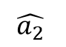
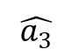
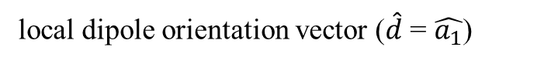
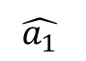
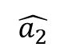
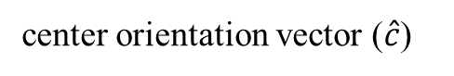
Fig 3
(a)
(b)
$$\hat{a_{1}}$$
$$\hat{a_{2}}$$
$$\hat{a_{3}}$$
4.5Å
local dipole orientation vector ($\hat{d}$ = $\hat{a_{1}}$)
Residue center
center orientation vector ($\hat{c}$)
Probe
$$\hat{a_{2}}$$

Slide 5
Input structure
Fig 4
Node features
Edge features
Atom type Embedding
SE(3)-Transformer
LayerNorm
Interaction module
ELU
6 SE(3)-Transformer
blocks
ConvSE3
LayerNorm
ELU
Structure module
6 linear blocks
LinearSE3
Displacement vector
Probability-like score
RMSD loss
Cross entropy loss

Slide 6
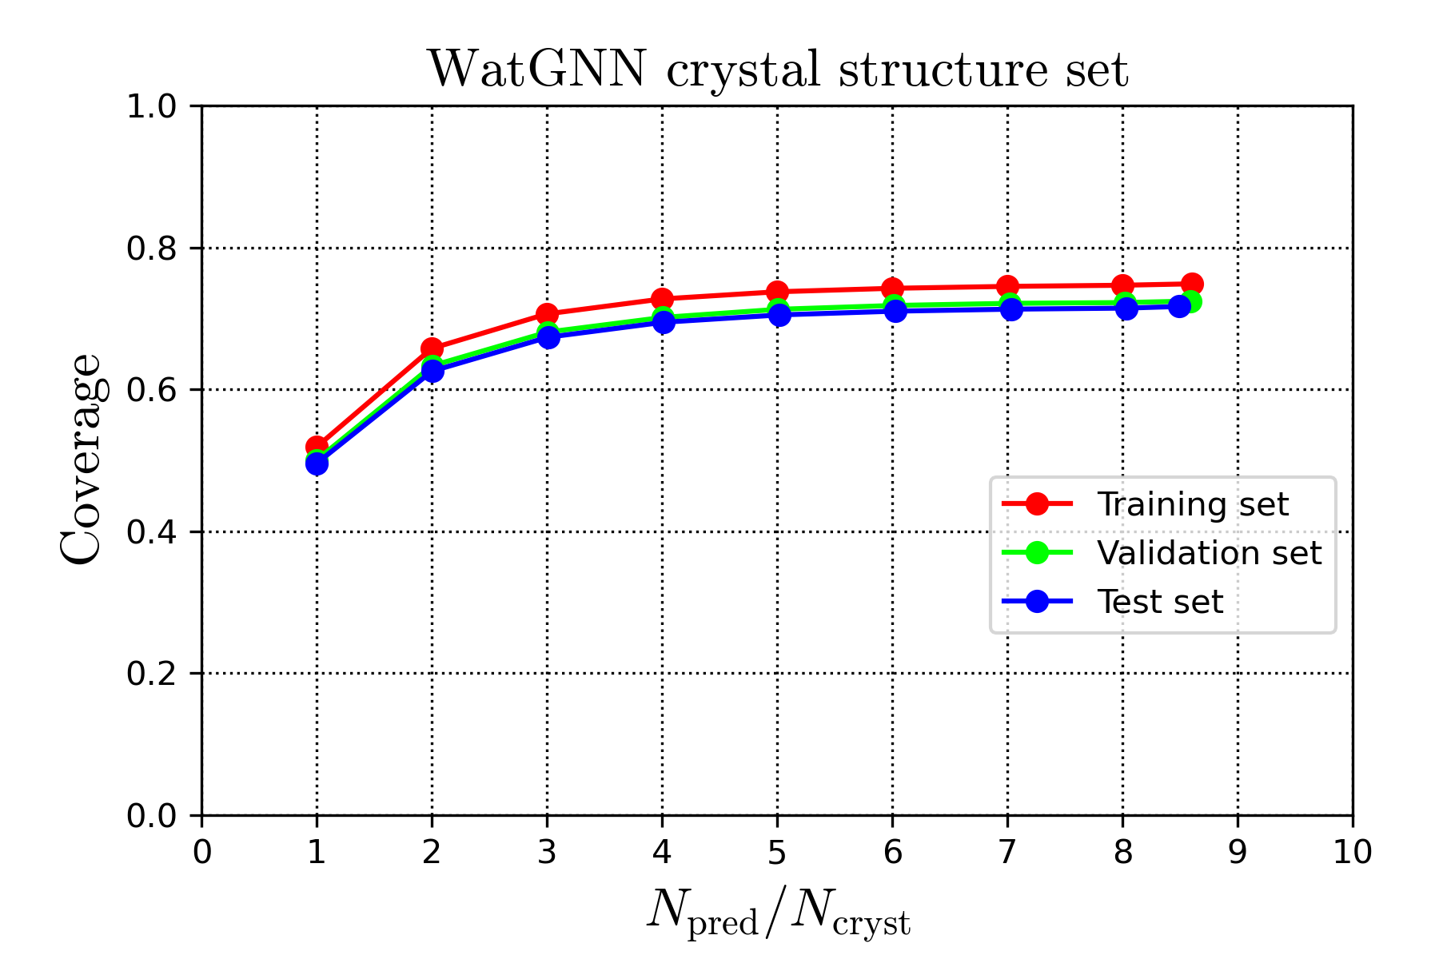
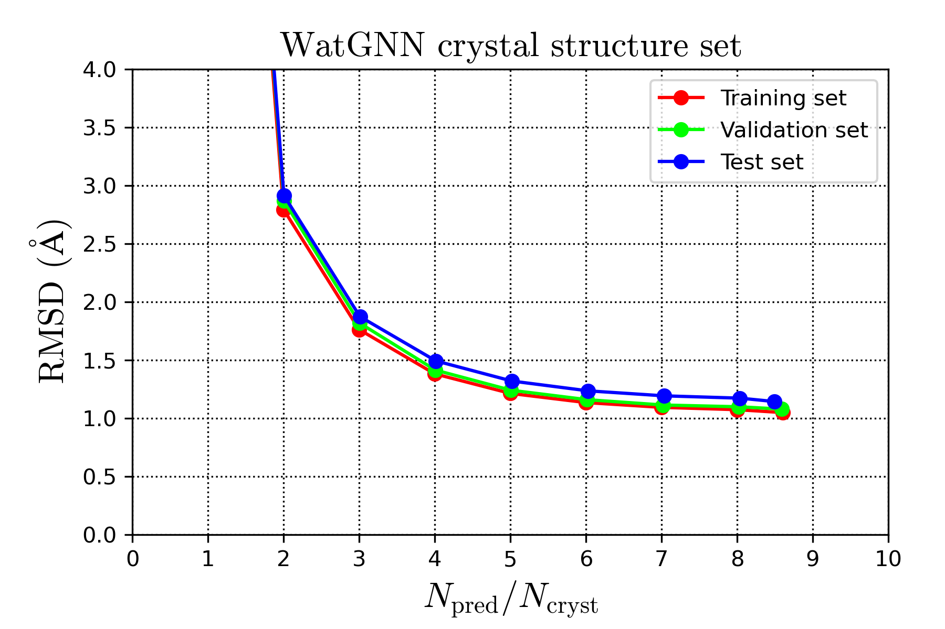
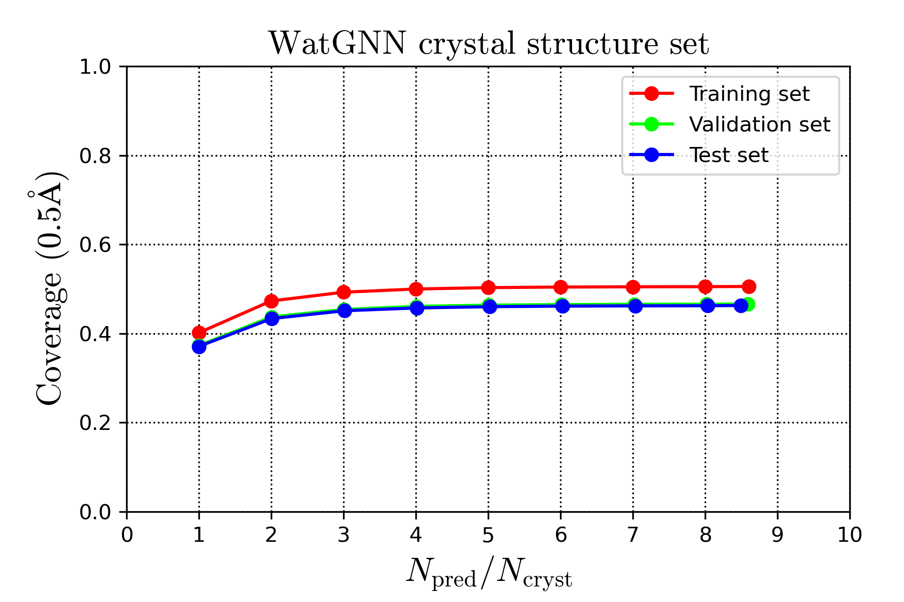
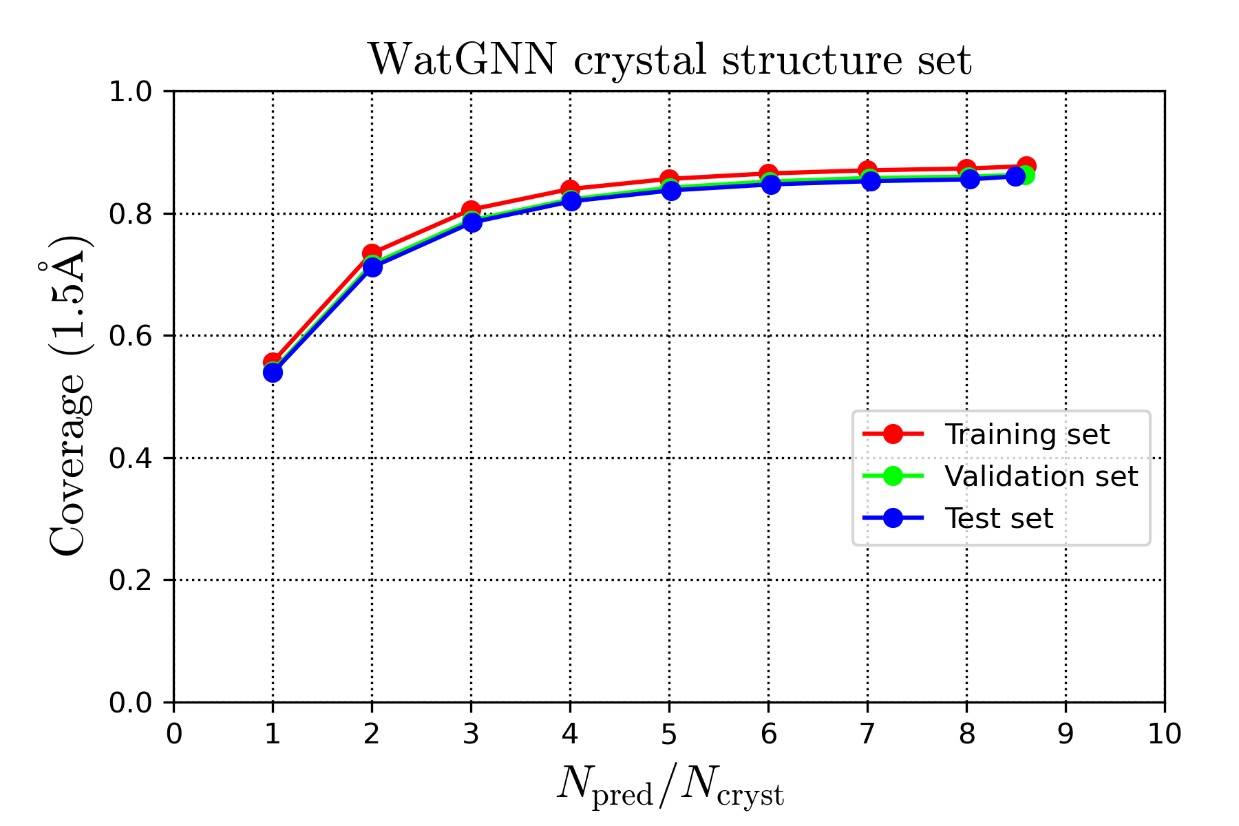
Fig 5
(a)
(b)
(c)
(d)

Slide 7
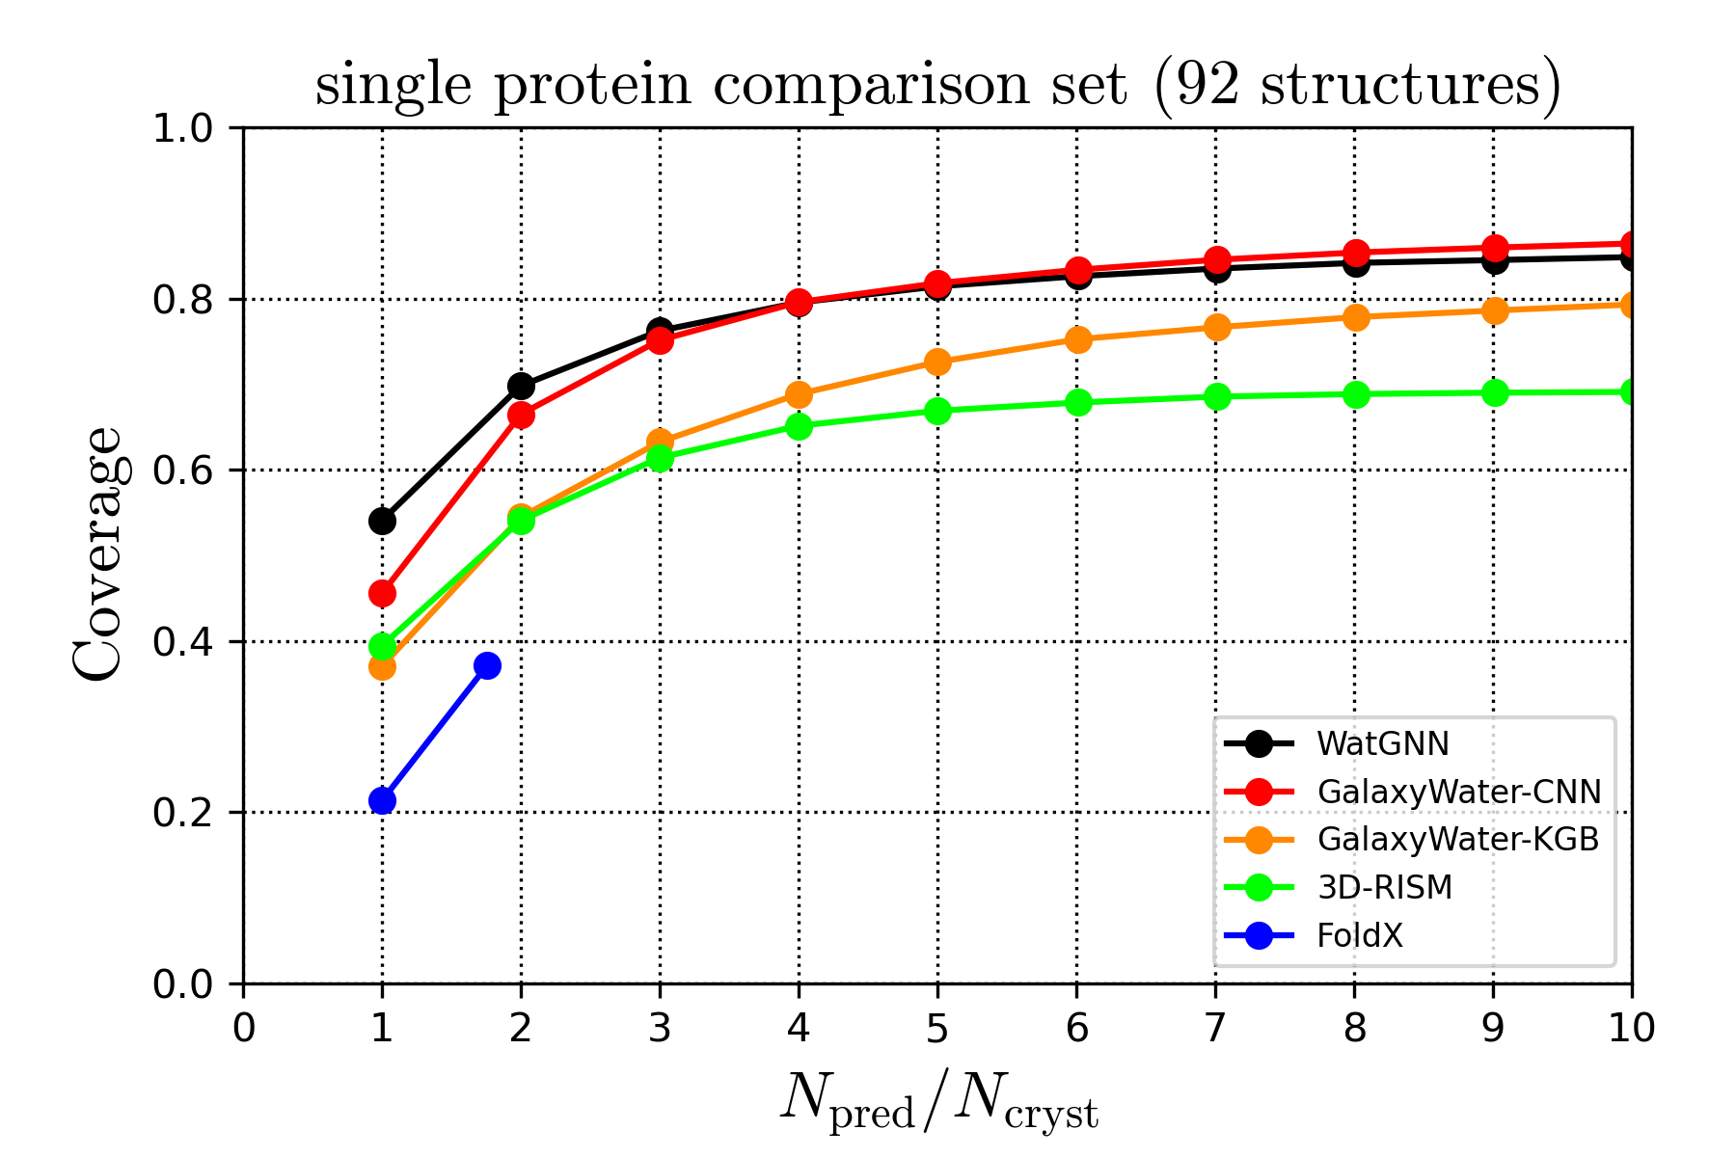
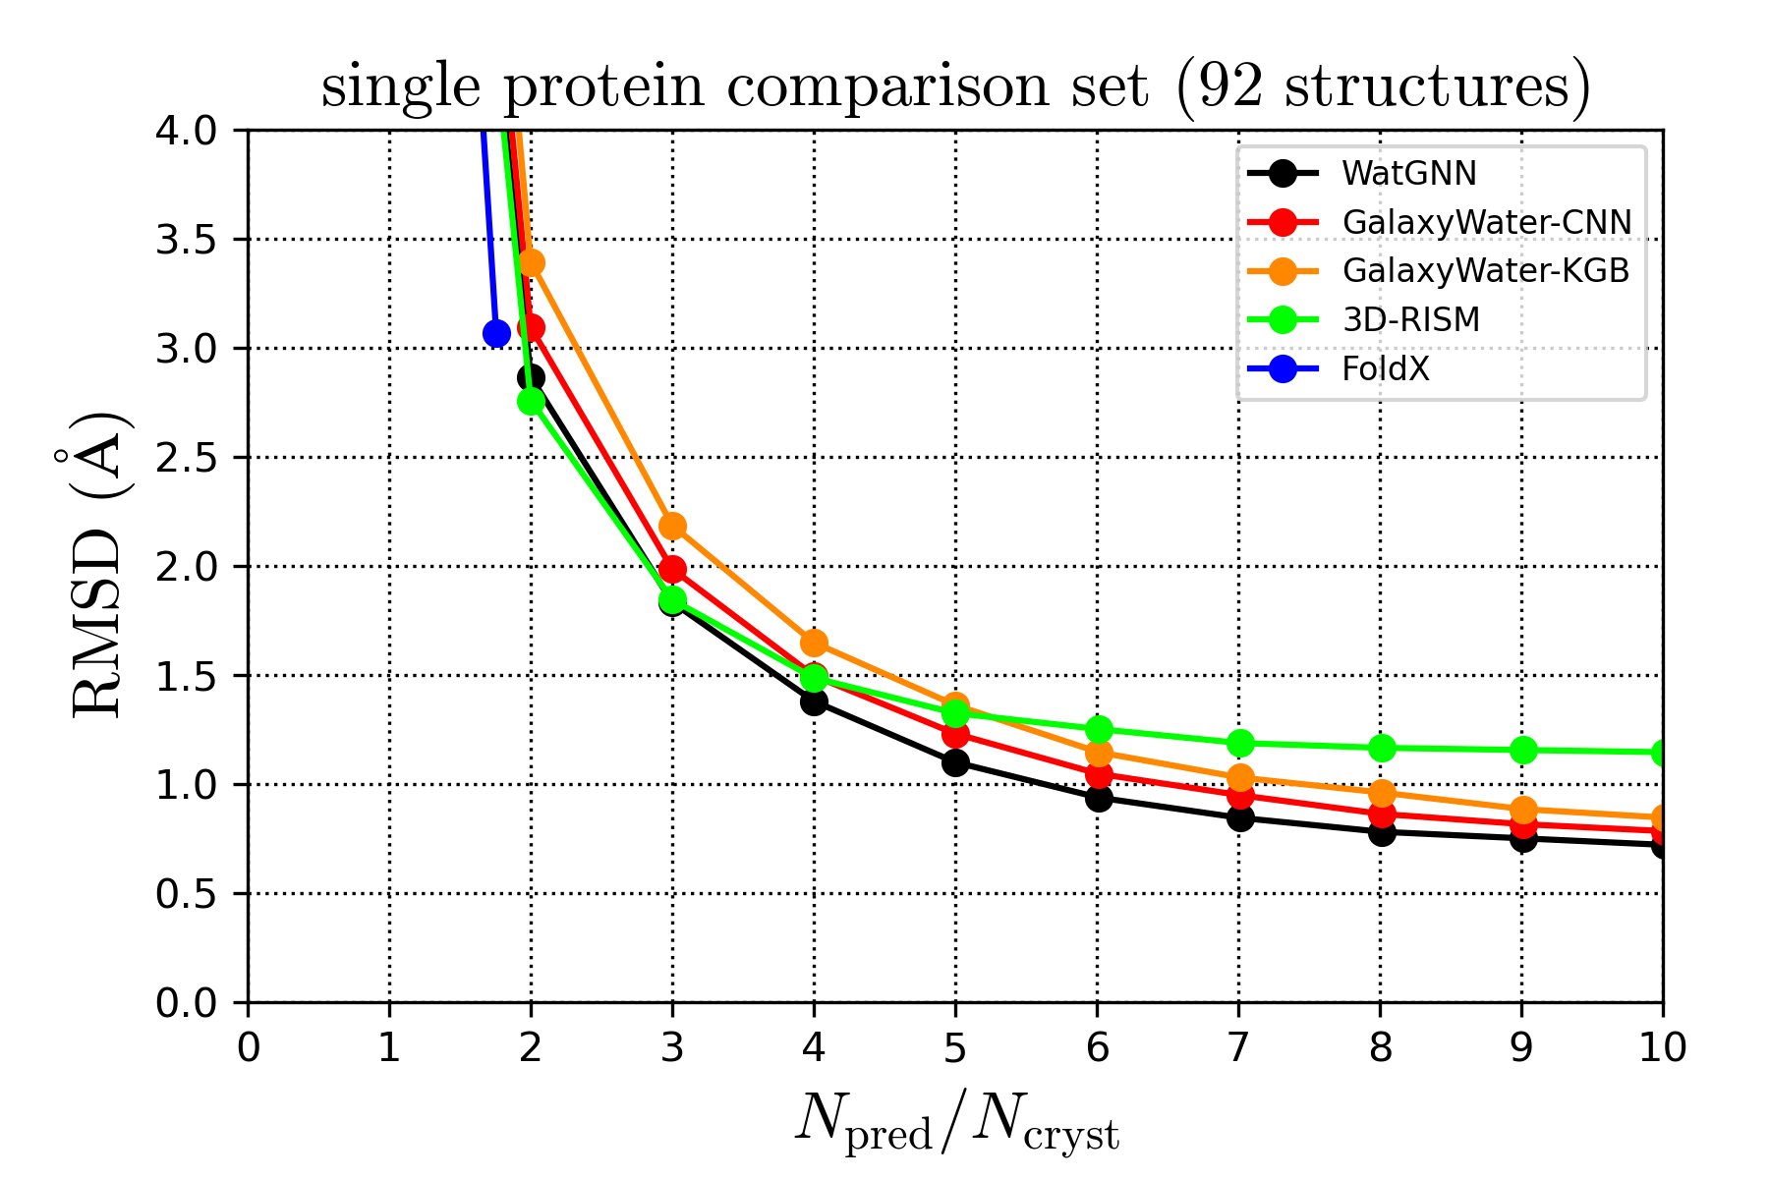
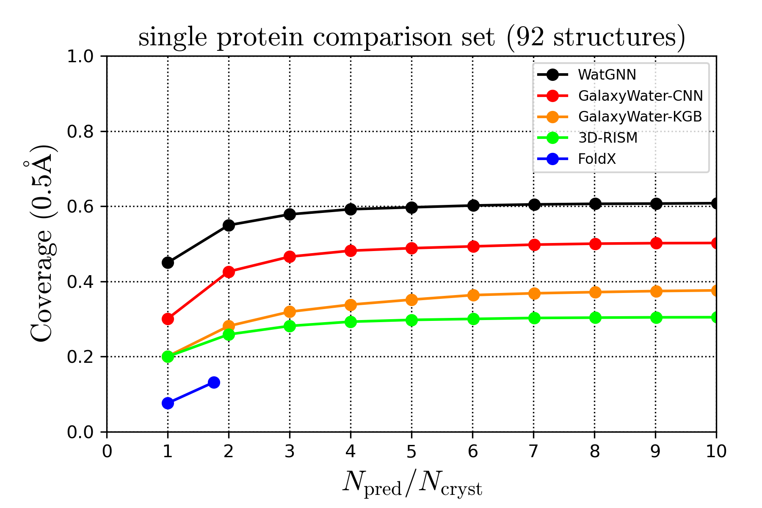
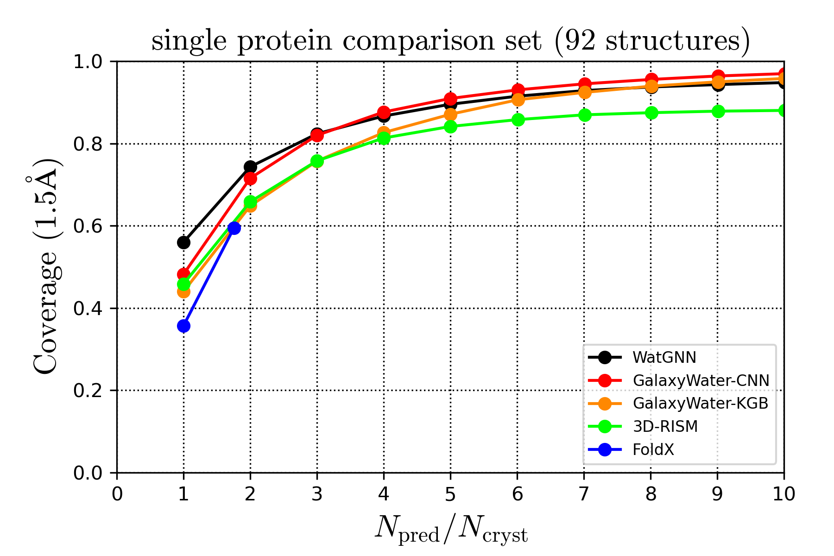
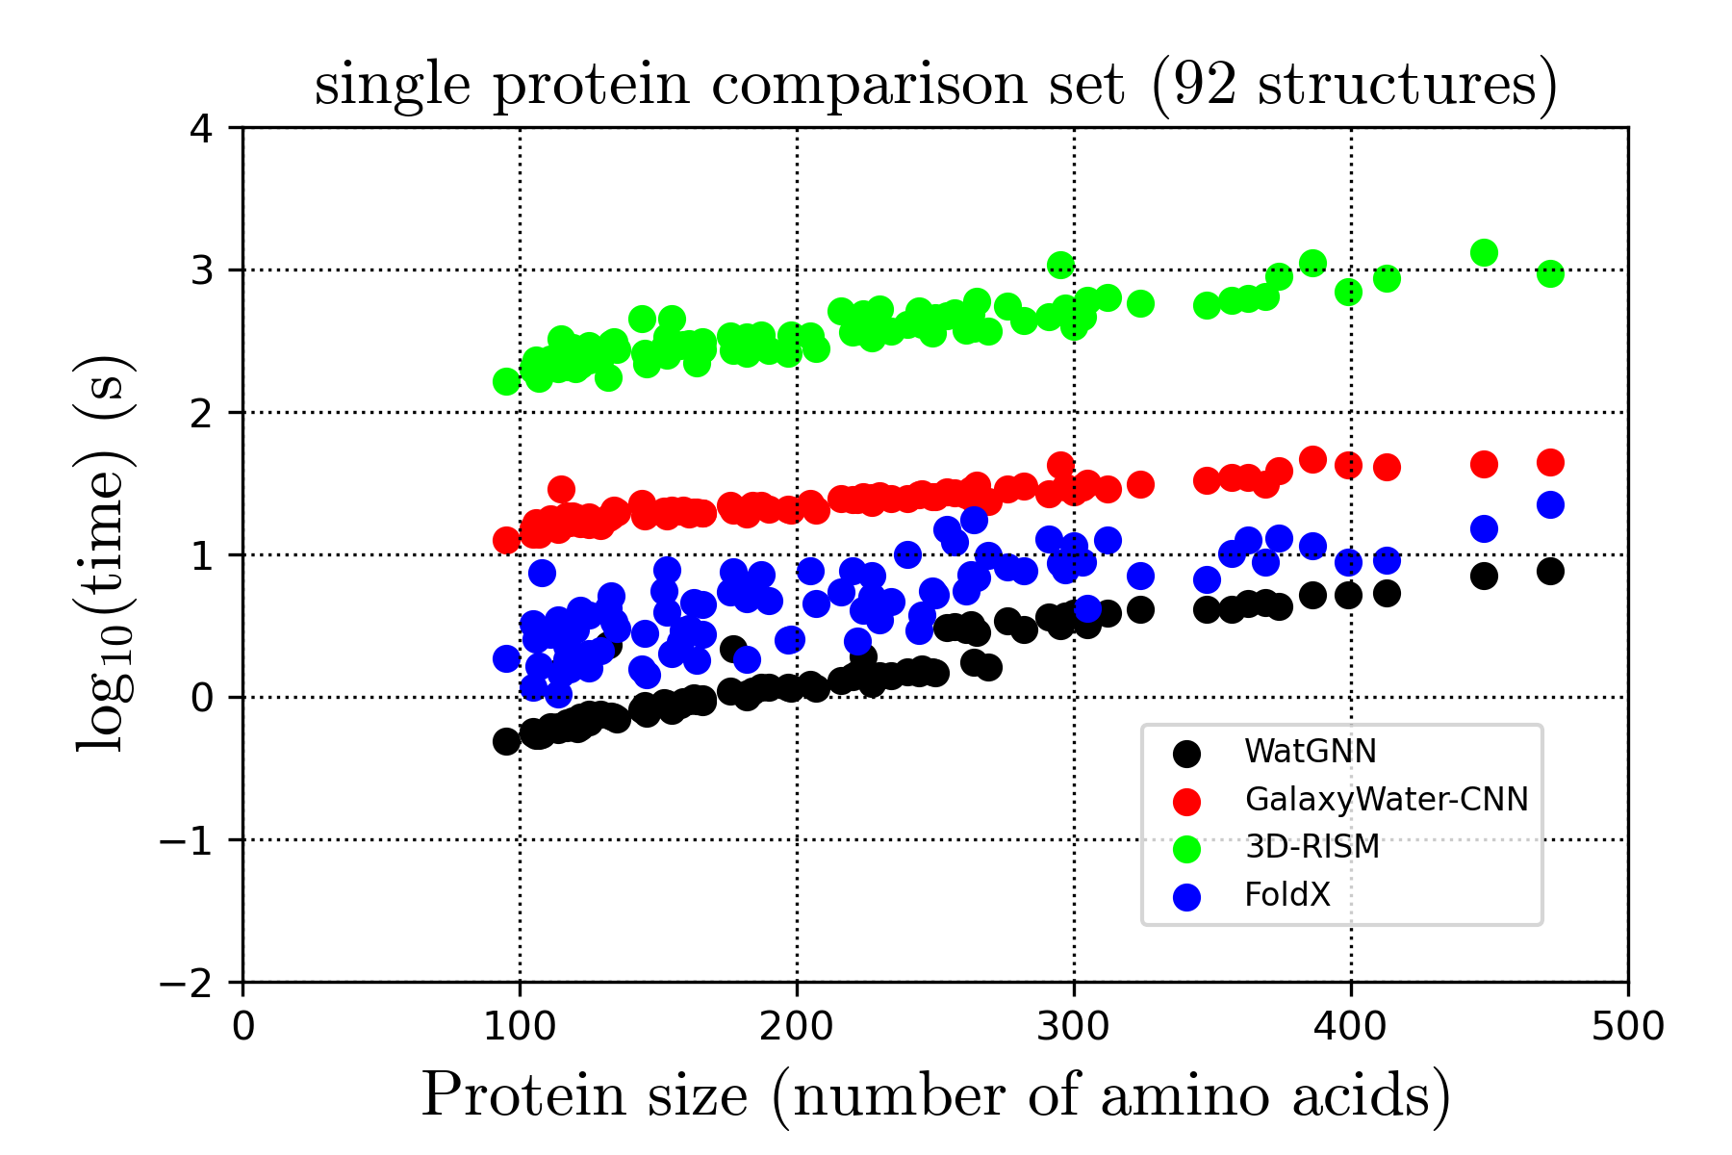
Fig 6
(a)
(b)
(c)
(d)
(e)

Slide 8
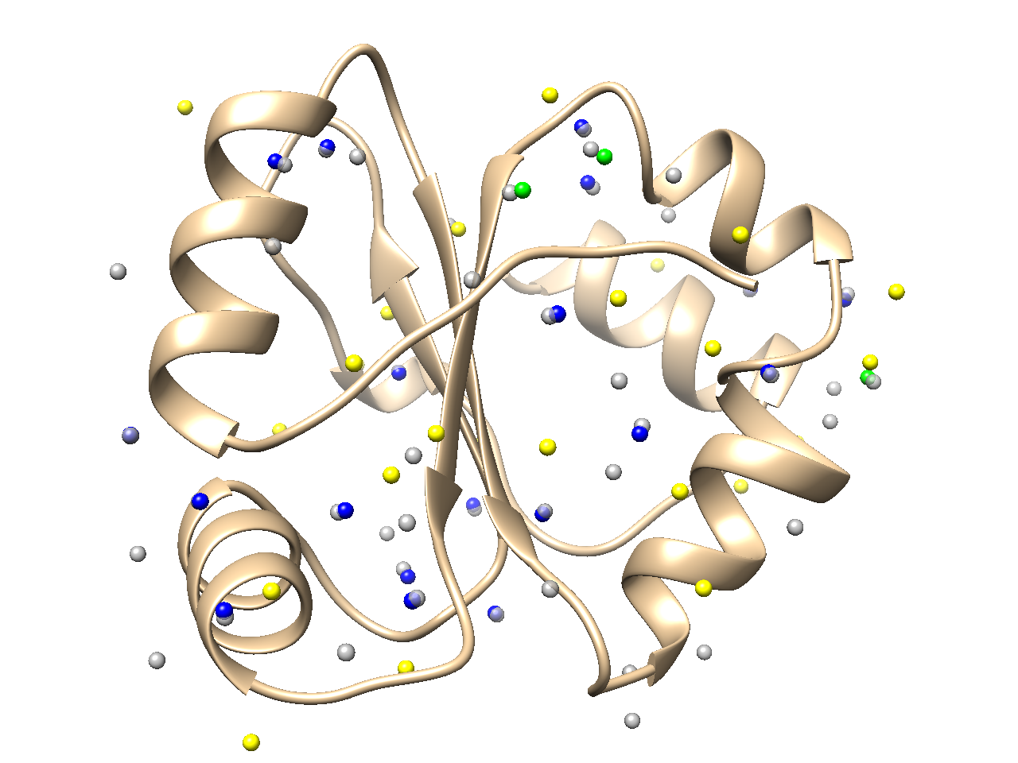
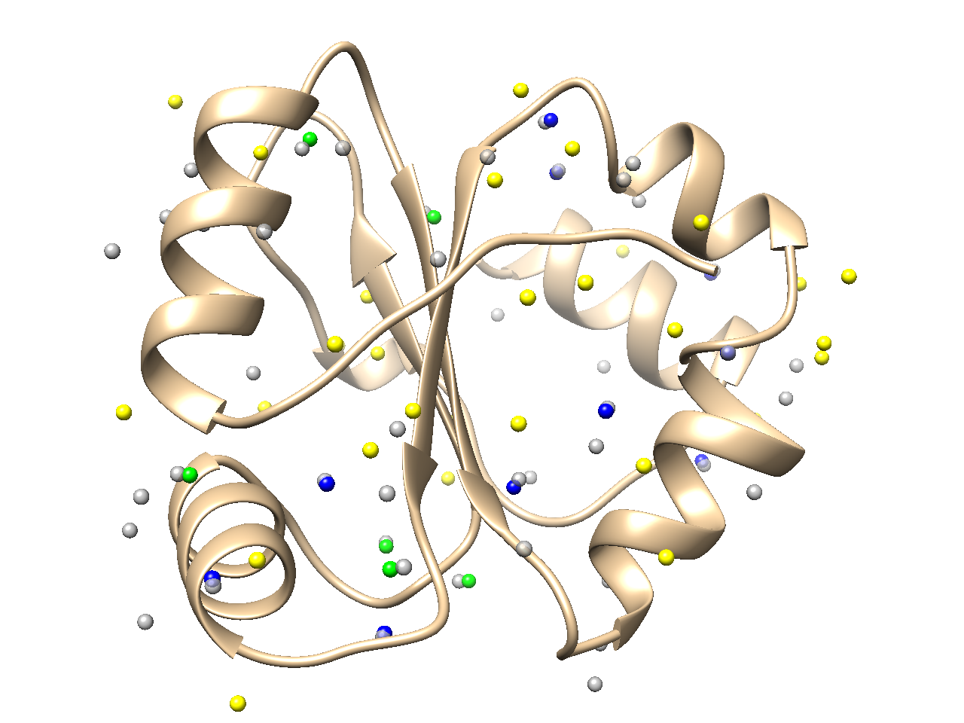
Fig 7
(a)
(b)

Slide 9
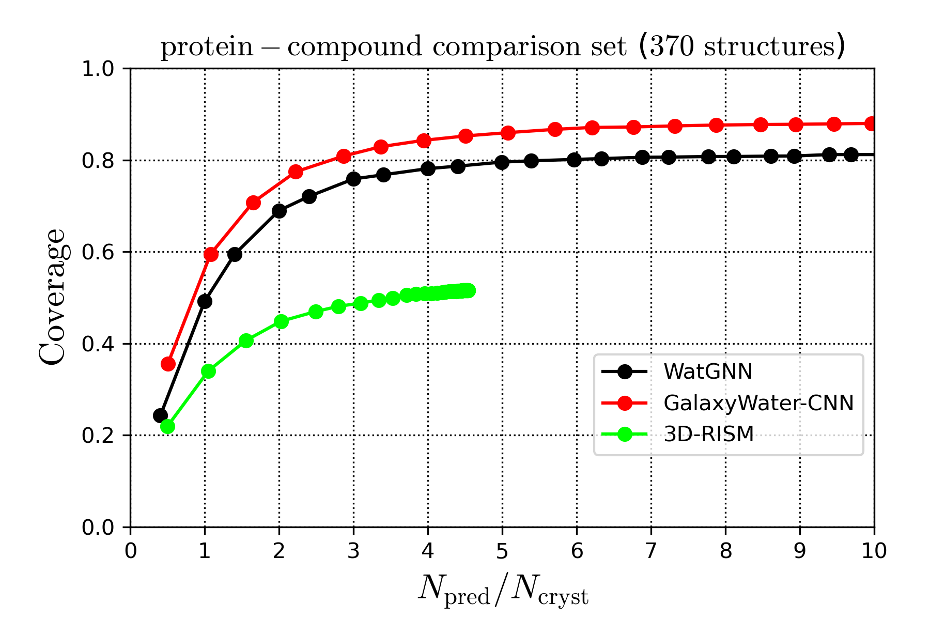
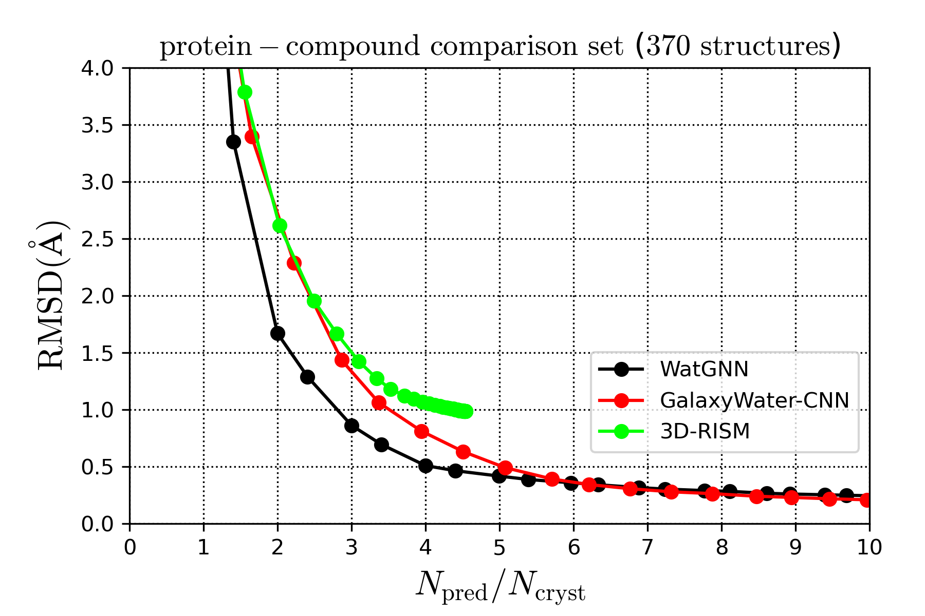
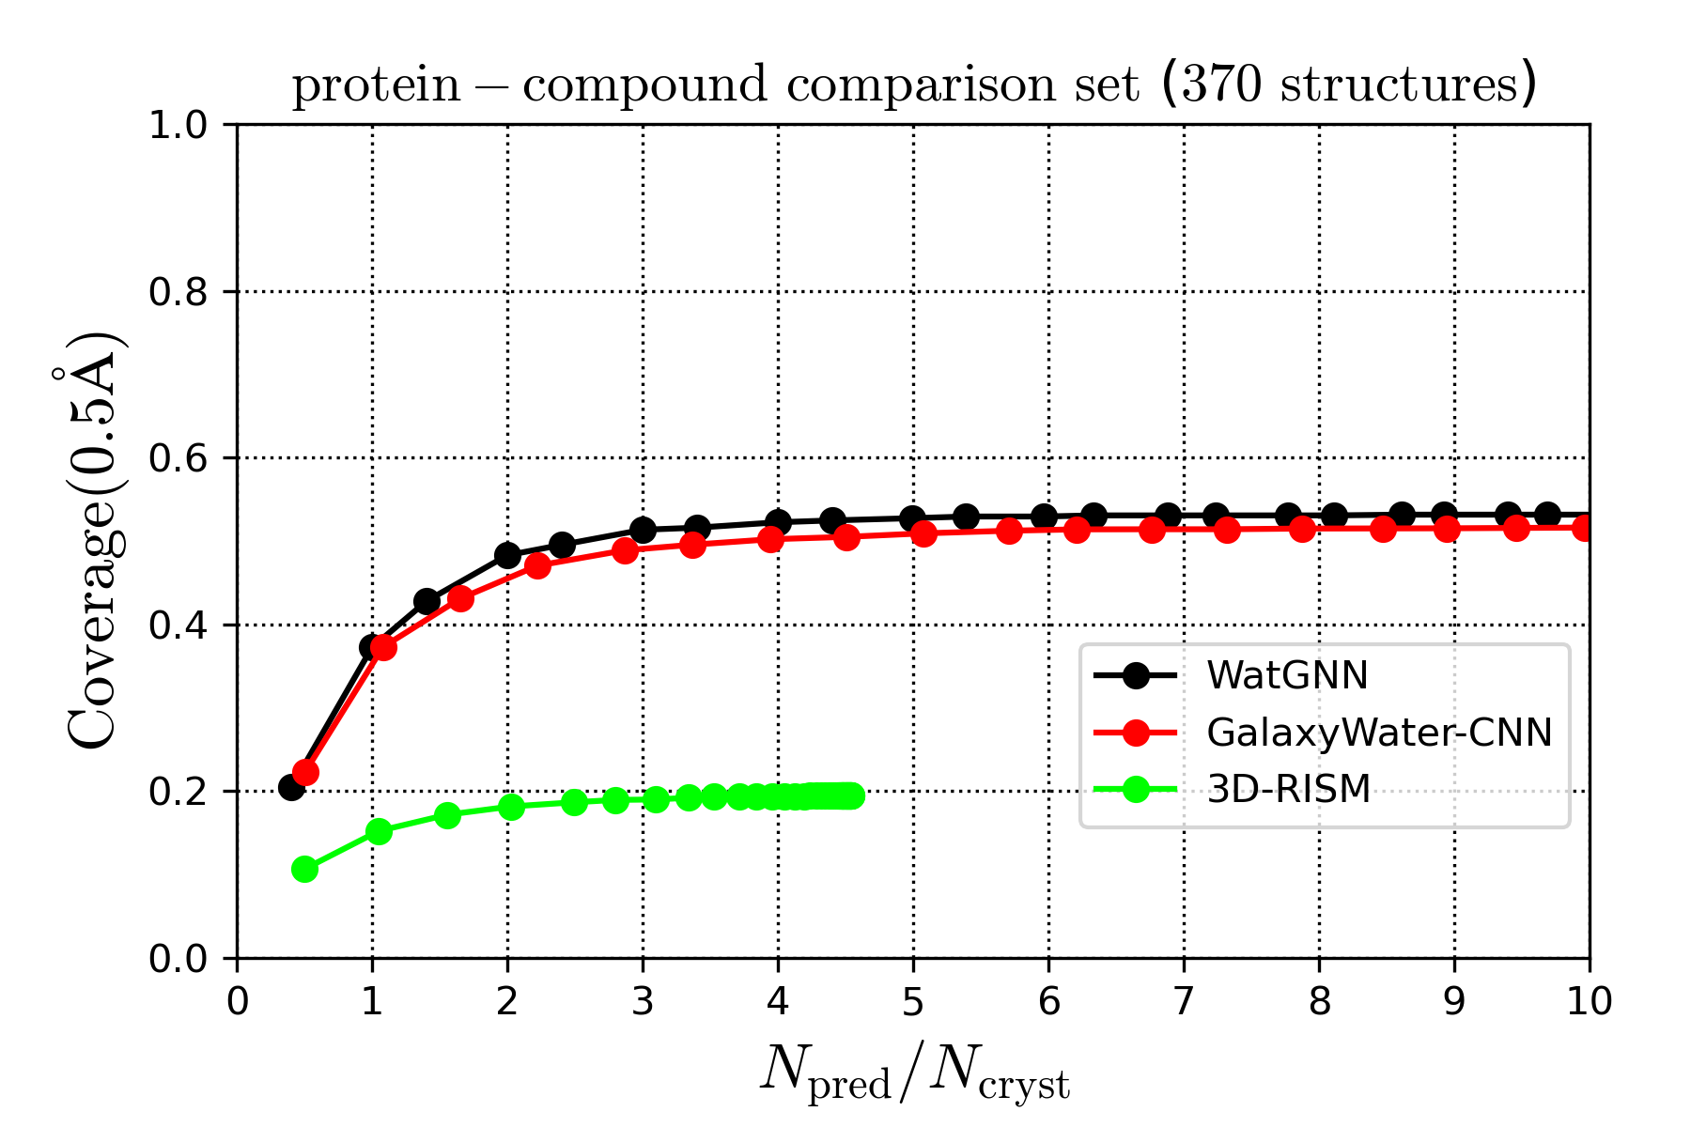
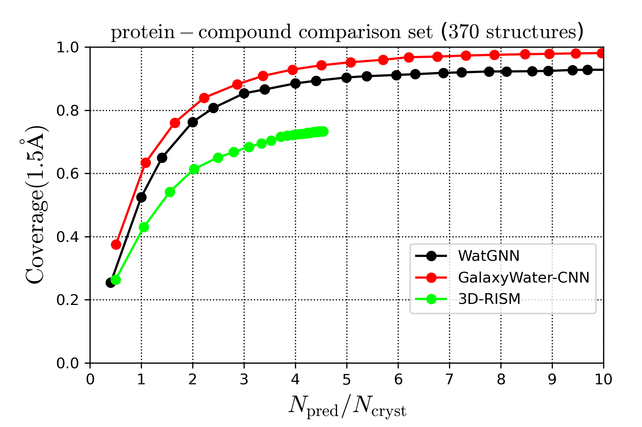
Fig 8
(a)
(b)
(c)
(d)

Slide 10
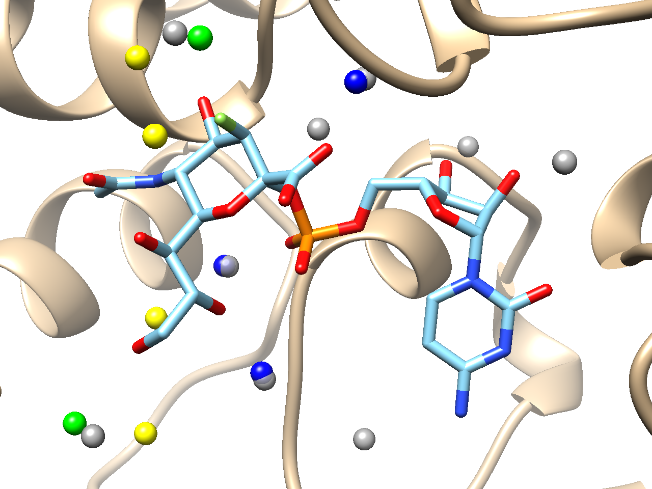
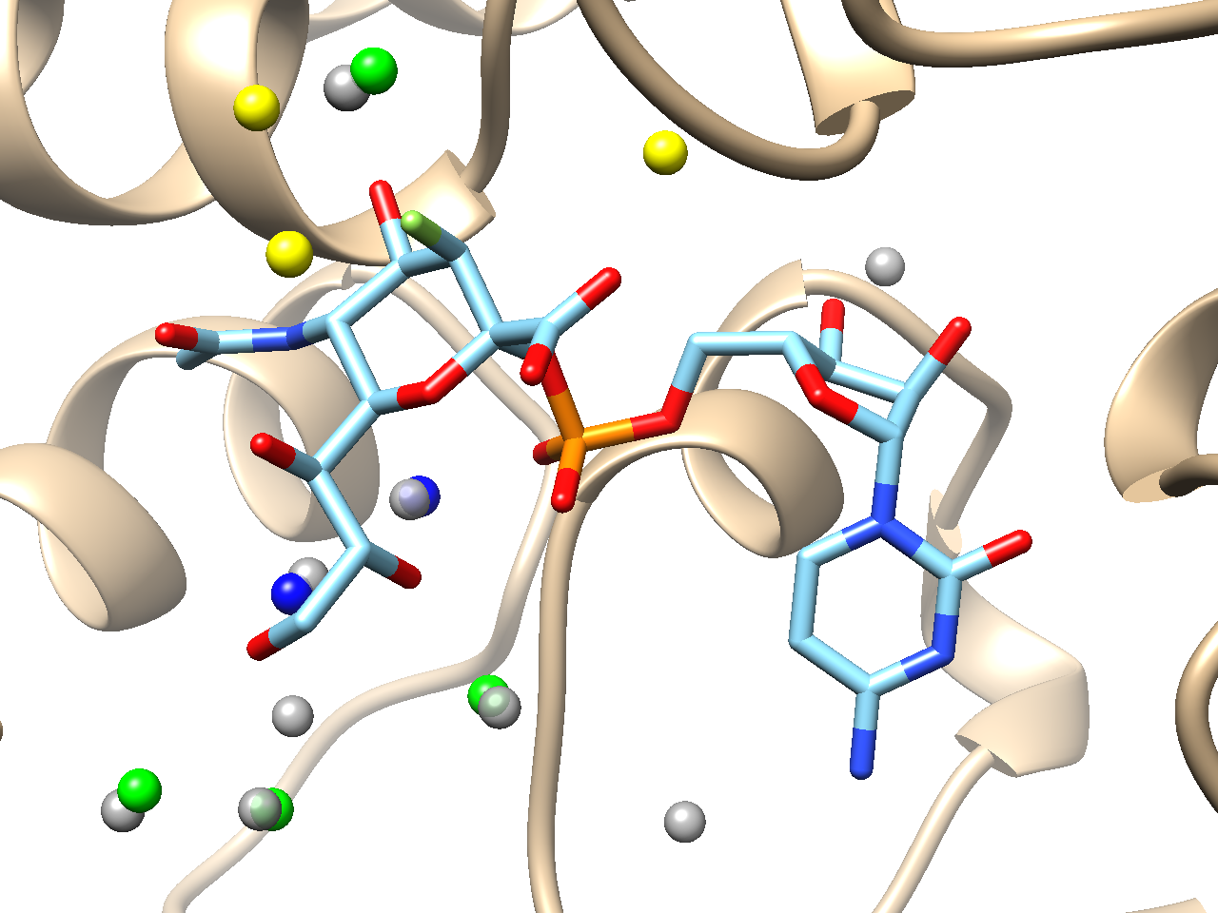
Fig 9
(a)
(b)

